Slide 1

PIZZA SALES ANALYSIS
PROJECT #1
UNCOVERING INSIGHTS FROM SALES DATA
BY-KABIR PANDYA(MAY 2024)
MY GITHUB REPOSITORY: https://github.com/Kabirqwe1/PSA-Kabir-Pandya-

Slide 2
PURPOSE OF ANALYSIS
The primary goal of this analysis is to leverage pizza sales data to uncover key business insights that can help improve sales strategies, enhance customer satisfaction, and optimize operations.

Slide 3
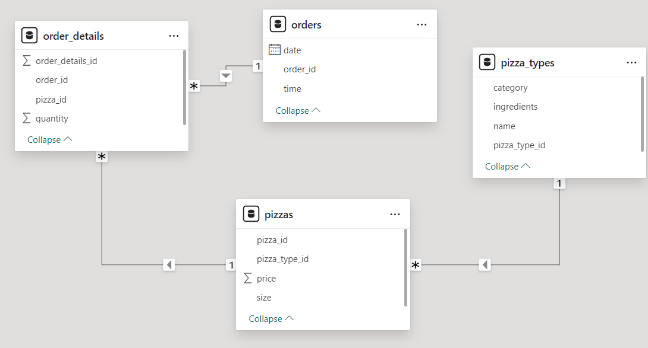
SCHEMA & DATA

Slide 4
QUERIES: BASIC
1. Retrieve the total number of orders placed.
2 .Calculate the total revenue generated from pizza sales.
3. Identify the highest-priced pizza.
4. Identify the most common pizza size ordered.
5. List the top 5 most ordered pizza types along with their quantities.

Slide 5
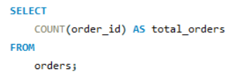

BASIC QUERIES
1. Retrieve The Total Number Of Orders Placed.

Slide 6
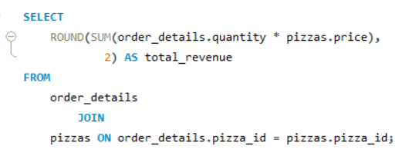

BASIC QUERIES
2 .Calculate the total revenue generated from pizza sales.

Slide 7
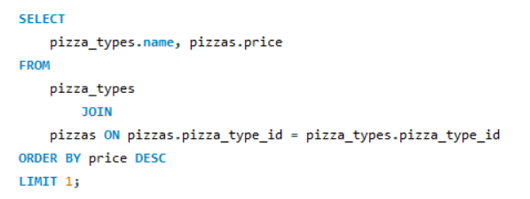

BASIC QUERIES
3. Identify the highest-priced pizza.

Slide 8
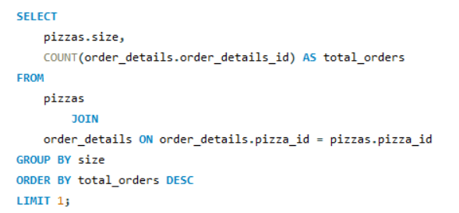

BASIC QUERIES
4. Identify the most common pizza size ordered.

Slide 9
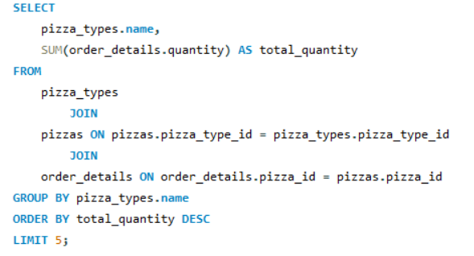
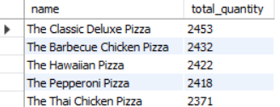
BASIC QUERIES
5. List the top 5 most ordered pizza types along with their quantities.

Slide 10
QUERIES: INTERMIDIATE
1. Total Quantity by Pizza Category
2. Hourly Order Distribution
3. Category-Wise Pizza Distribution
4. Daily Average Orders
5. Top 3 Pizzas by Revenue

Slide 11
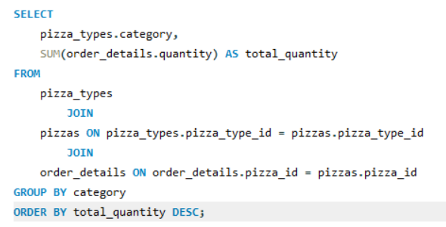
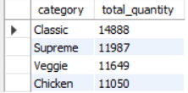
INTERMIDIATE QUERIES
1. Total Quantity by Pizza Category

Slide 12
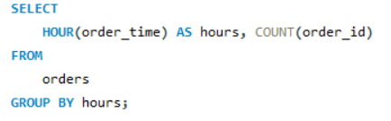
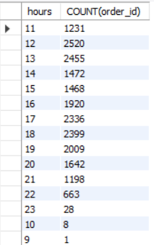
INTERMIDIATE QUERIES
2. Hourly Order Distribution

Slide 13

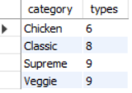
INTERMIDIATE QUERIES
3. Category-Wise Pizza Distribution

Slide 14
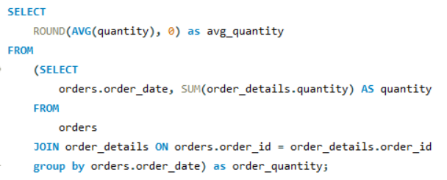

INTERMIDIATE QUERIES
4. Daily Average Orders

Slide 15
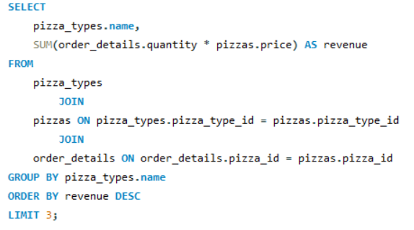

INTERMIDIATE QUERIES
5. Top 3 Pizzas by Revenue

Slide 16
QUERIES: ADVANCED
1. Calculate the percentage contribution of each pizza type to total revenue.
2. Analyze the cumulative revenue generated over time.
3. Determine the top 3 most ordered pizza types based on revenue for each pizza category.

Slide 17
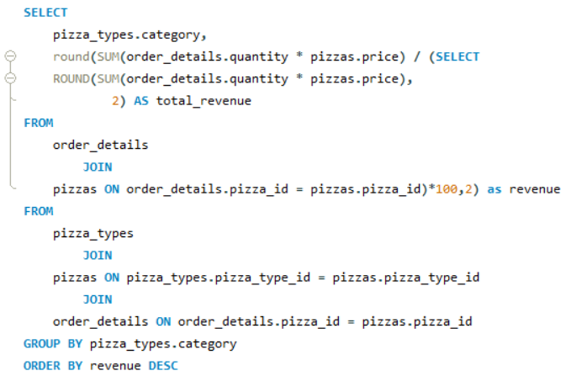
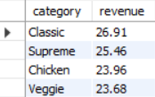
ADVANCED QUERIES
1. Calculate the percentage contribution of each pizza type to total revenue.

Slide 18
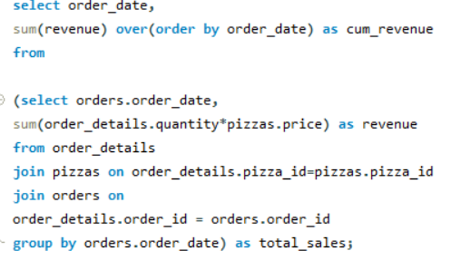
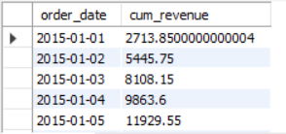
ADVANCED QUERIES
2. Analyze the cumulative revenue generated over time.

Slide 19
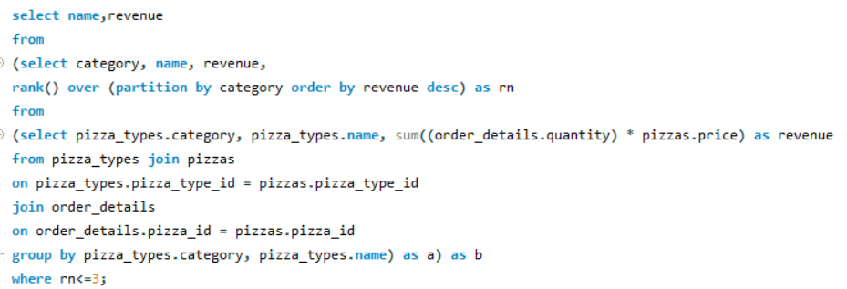
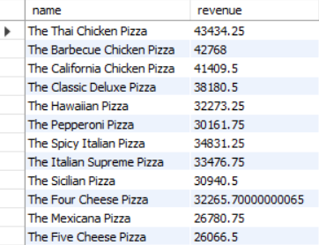
ADVANCED QUERIES
3. Determine the top 3 most ordered pizza types based on revenue for each pizza category.

Slide 20
INSIGHTS
1. The Veg category has the highest total quantity ordered, indicating a strong preference for vegetarian options among customers.
2. Peak order times are around lunch (12 PM - 2 PM) and dinner (6 PM - 8 PM).
3. Non-Veg pizzas also have a significant share, particularly popular in larger sizes.
4. The top 3 pizzas contributing the most to revenue are The Thai Chicken Pizza, The Barbecue Chicken Pizza, and The California Chicken Pizza.
5. Classis And Supreme Pizzas are the most ordered Pizzas

Slide 21
SUGGESTION TO INCREASE SALES
Consider expanding the Veg menu to include more variety or special offers to boost sales further.
Optimize staffing and kitchen operations during peak hours to ensure timely service and maximize order fulfillment.
Introduce combo deals or meal packages that include popular Non-Veg pizzas to increase average order value.
Enhance loyalty programs to reward frequent customers with discounts, free items, or exclusive deals, encouraging repeat business.
Focus marketing efforts on these top sellers with special promotions, feature them prominently on the menu, and ensure consistent availability.

